Slide 1
Microsoft Azure
Introduction to Microsoft Azure cloud

Slide 2
Topics to be Covered
Motivation to Cloud Computing
An Overview of Cloud Computing
Models of Cloud Computing
Service model
Deployment model
An Introduction to micro soft Azure
Micro Soft Azure Services

Slide 3
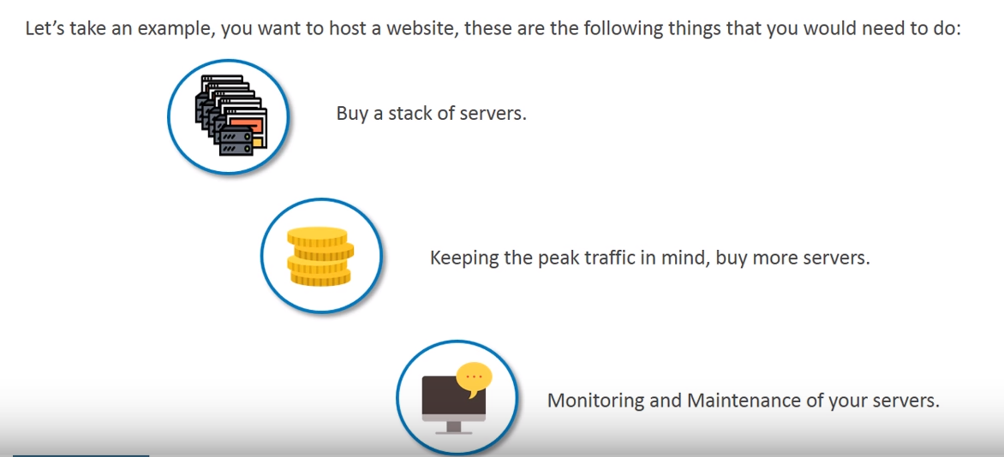
Before Cloud Computing

Slide 4
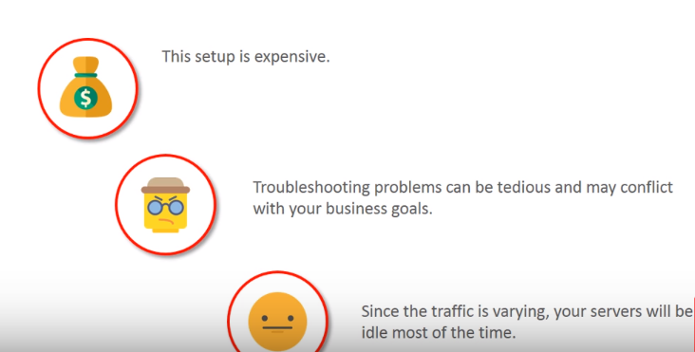
Before Cloud Computing Disadvantages

Slide 5
Motivation to Cloud
According to Goldman Sachs, spending on cloud computing infrastructure and platforms will grow at a 30% compound annual growth rate (CAGR) from 2013 through 2018 compared with 5 percent growth for overall enterprise IT, giving rise to the Cloud access security broker (CASB) market in the process.
Cloud access security brokers (CASB) are on-premises or cloud-hosted software that sit between cloud service consumers and cloud service providers to enforce security, compliance, and governance policies for cloud applications. CASBs help organizations extend the security controls of their on-premises infrastructure to the cloud.

Slide 6
Motivation to Cloud(Con…)
Fresh Software: With SaaS, the latest versions of the applications needed to run the business are made available to all customers as soon as they’re released.
Flexible costs: The costs of cloud computing are much more flexible than traditional methods. Companies only need to commission – and thus only pay for – server and infrastructure capacity as and when it is needed.
Always-on availability: Most cloud providers are extremely reliable in providing their services, with many maintaining 99.99% uptime.
Flexible capacity: Cloud is the flexible facility that can be turned up, down or off depending upon circumstances. For example, a sales promotion might be wildly popular, and capacity can be added quickly to avoid crashing servers and losing sales. When the sale is over, capacity can shrink to reduce costs.
Scalability :Scale to meet peak demands, Server Capacity will very according to traffic, if more scale up server if less scale down.

Slide 7
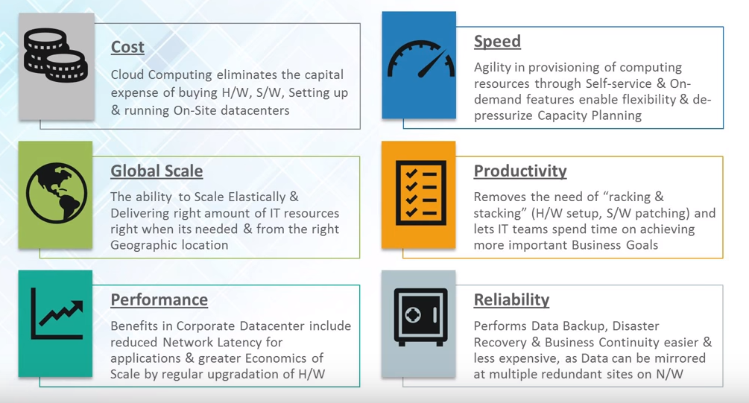
Motivation to Cloud(Con…)
:Schedule Servers

Slide 8
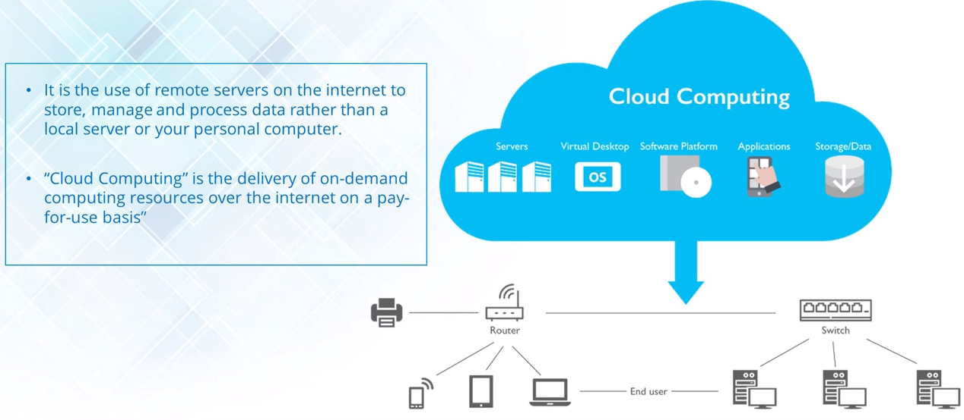
What is Cloud Computing

Slide 9
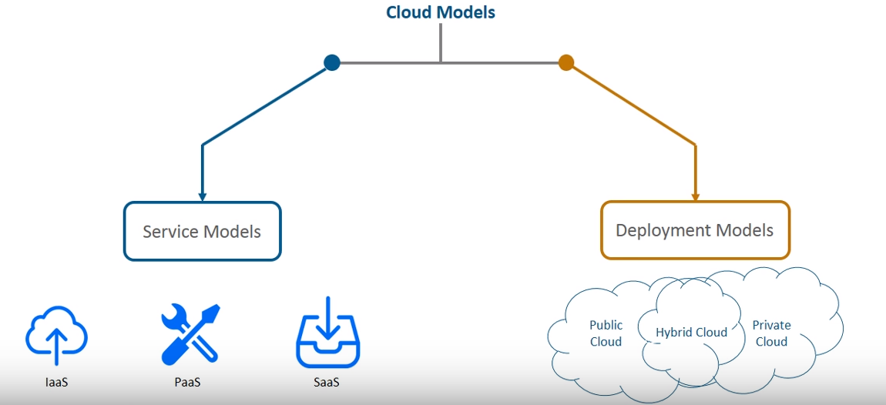
Cloud Models

Slide 10
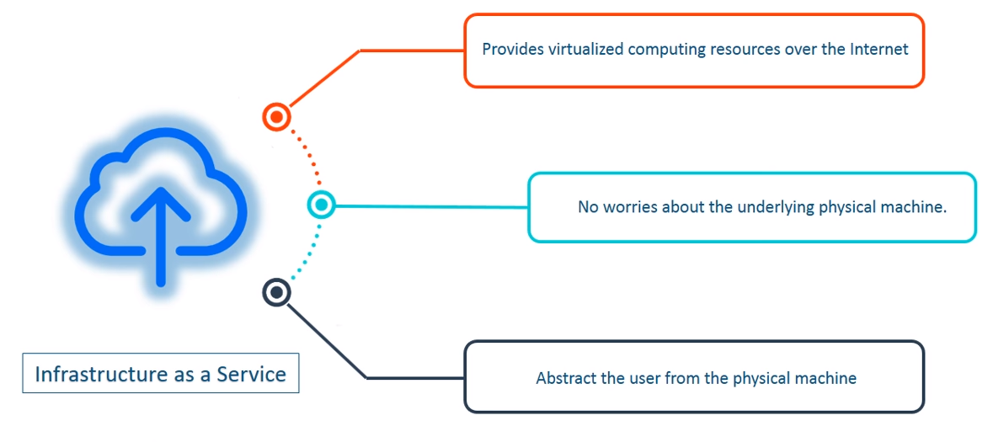
IaaS
IAAS: Provide computing infrastructure, Physical or virtual Machine and other resource like VM disk, Block and file based storage, Firewall load balancer, IP address VNET, Virtual Local area network all are part of IAAS.
E.g: Win Azure , Amazon EC2, Rack space, Google Compute engine.
Win Azure is microsoft operating system for cloud computing related to IAAS, used for development, service hosting and management.

Slide 11
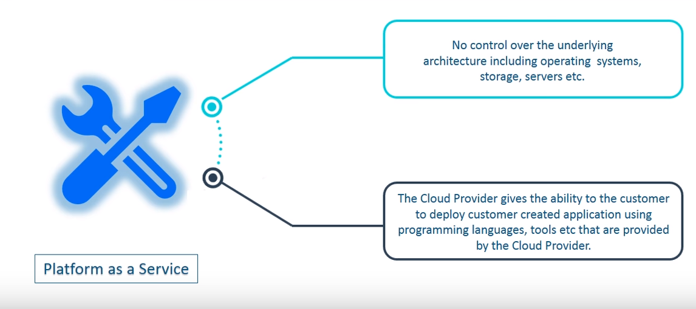
PaaS
PAAS: Provide platform which typically included OS, Programming language executing environment, databases, Storages, web servers etc.

Slide 12
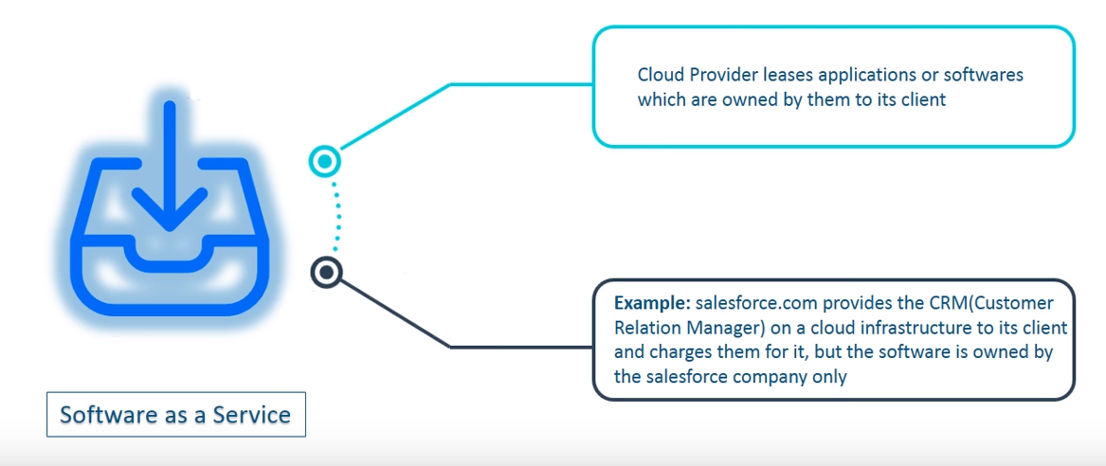
SaaS
SAAS: Provide access to application software often referred as to an “On demand software”, You don’t have to worry about installation, setup and running of application.
E.g: Google App, MS 365, yahoo, Gmail, Online PDF Converter etc.

Slide 13
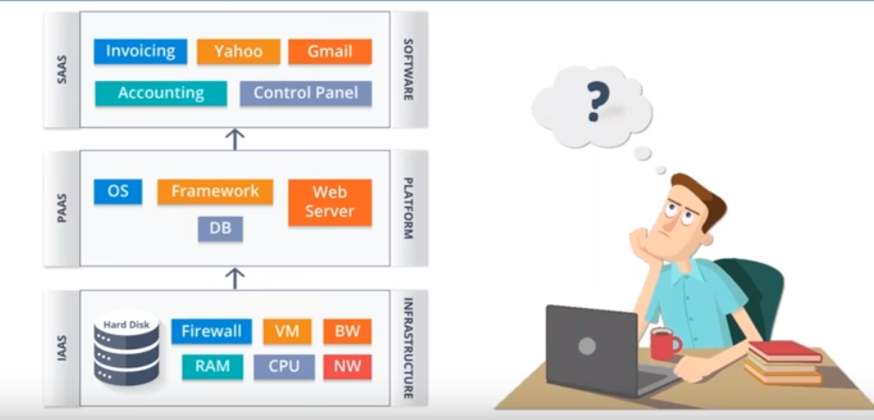
Service Models

Slide 14
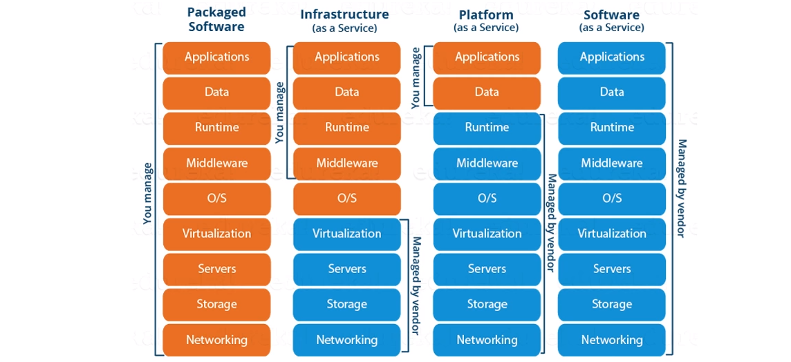
Service Models

Slide 15
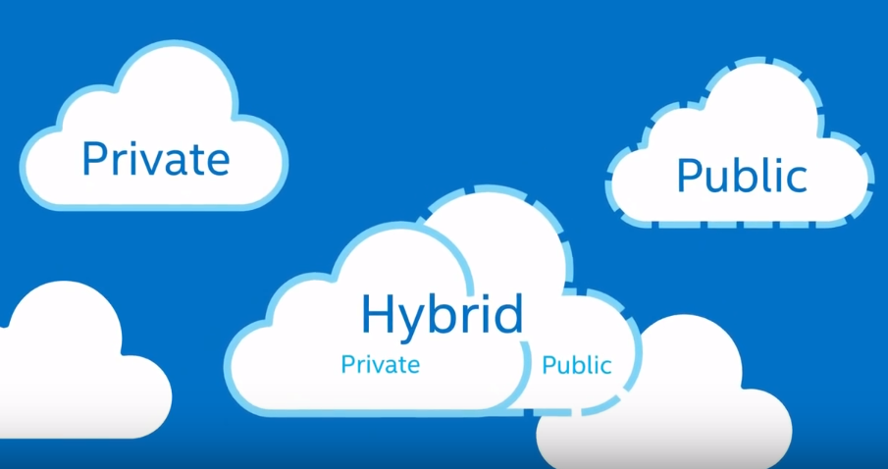
Deployment Models

Slide 16
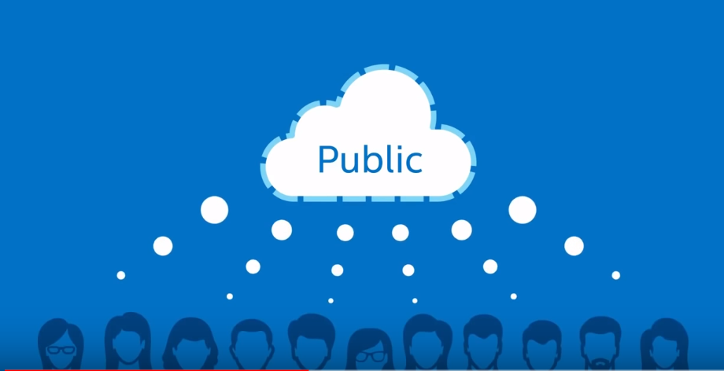
Public Cloud
Amazon, Google, Azure host a public cloud. Login to any of them pay what you use, its public to all.
Host infrastructure anyone can use that.

Slide 17
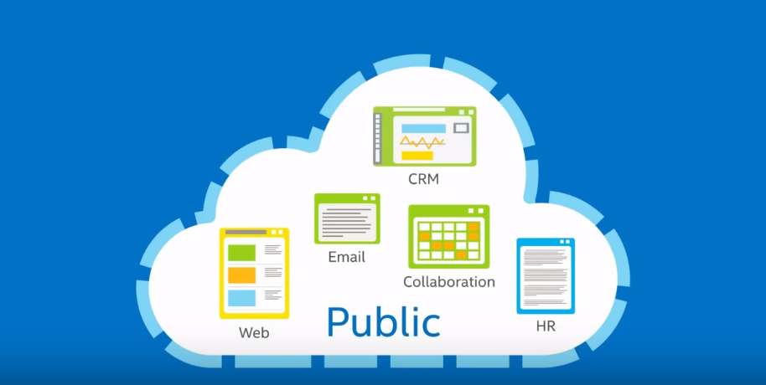
Public Cloud Con..

Slide 18
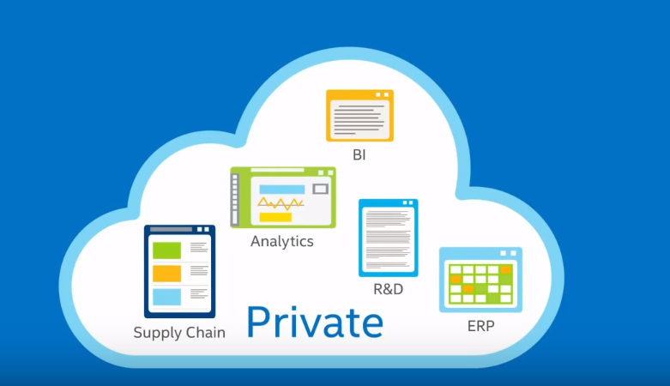
Private Cloud
Amazon, Google, Azure also provide private cloud on demand. If any Organization want some infrastructure need to ask to one of the cloud vendor, cloud vendor’s are going to allocate them some private cloud out of public cloud.

Slide 19
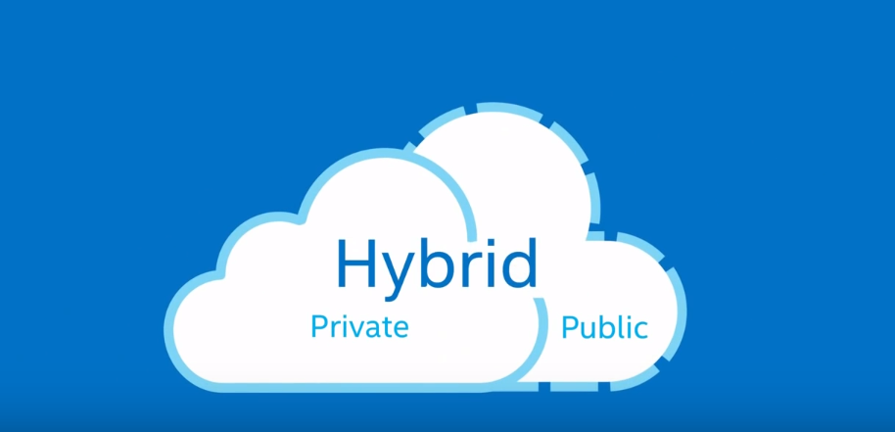
Hybrid Cloud
Any cloud provider can provide both private and public which is hybrid cloud.
Hybrid cloud enables an enterprise to deploy an on-prime private cloud to host sensitive or critical workloads, and use third party public cloud provider to host less critical resources, such as text, development workloads.

Slide 20
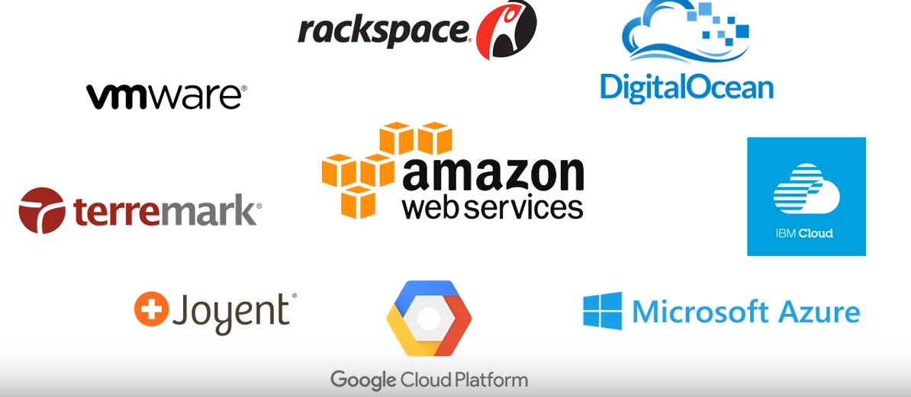
Cloud Providers

Slide 21
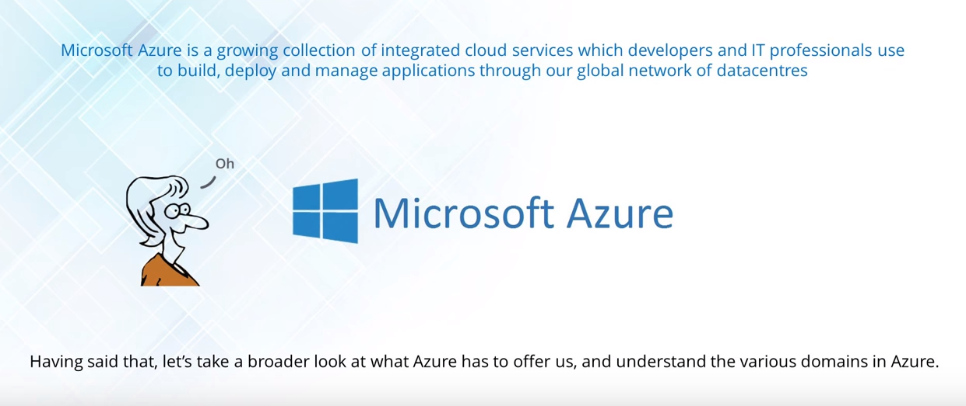
Microsoft Azure
User friendly
Portal released in 2015, Which is more use friendly.
Security, Improved their services in past years.
Free Trail with $200 so you can learn.
So many official leaning docs available and released by Microsoft.
Cheaper from Other(Flipkart moved to Azure)

Slide 22
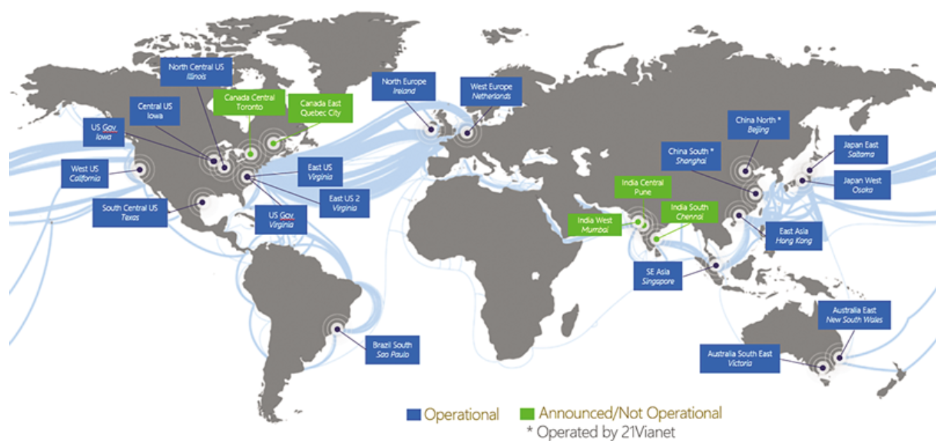
MS Azure Regions World Wide

Slide 23
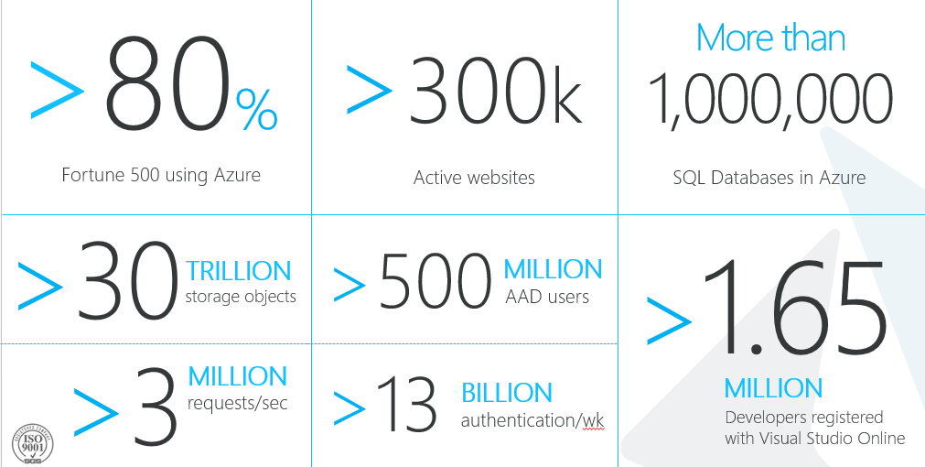
MS Azure till mid 2015

Slide 24
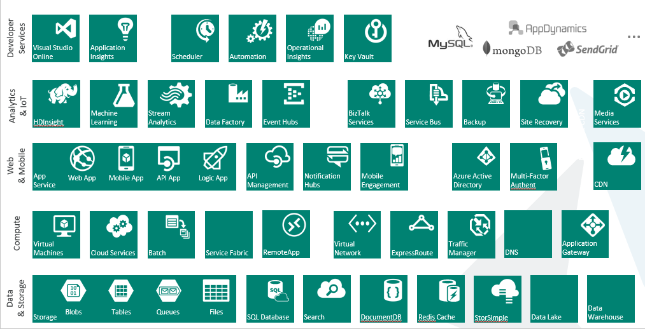
MS Azure Services

Slide 25
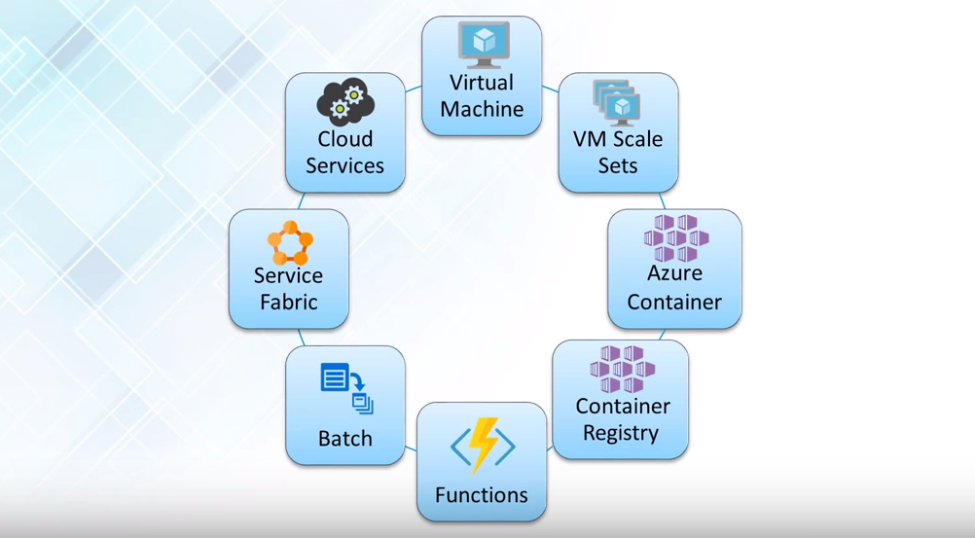
Azure Compute Services
Compute service related to your CPU and Memory Allocation to services

Slide 26
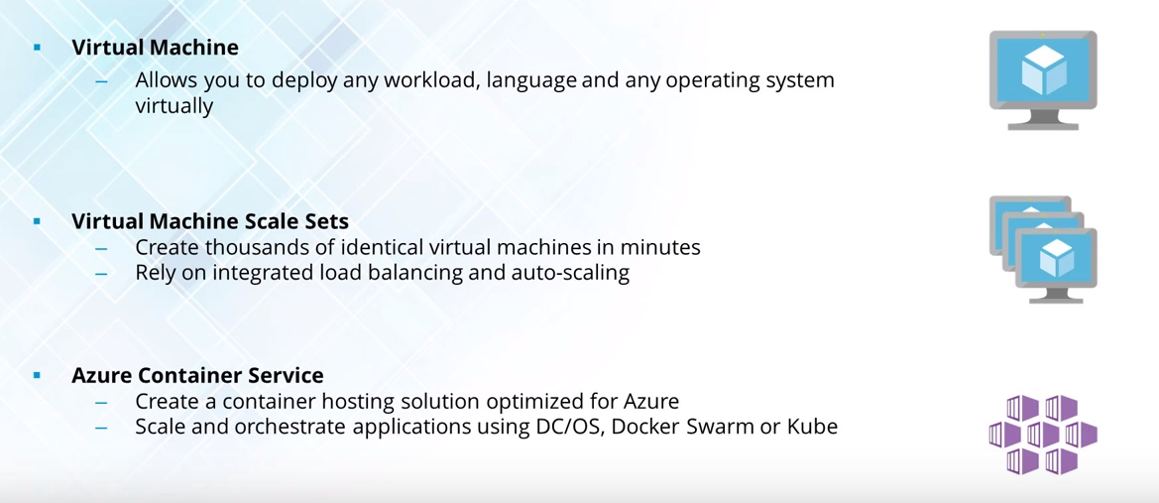
Compute Services con…

Slide 27
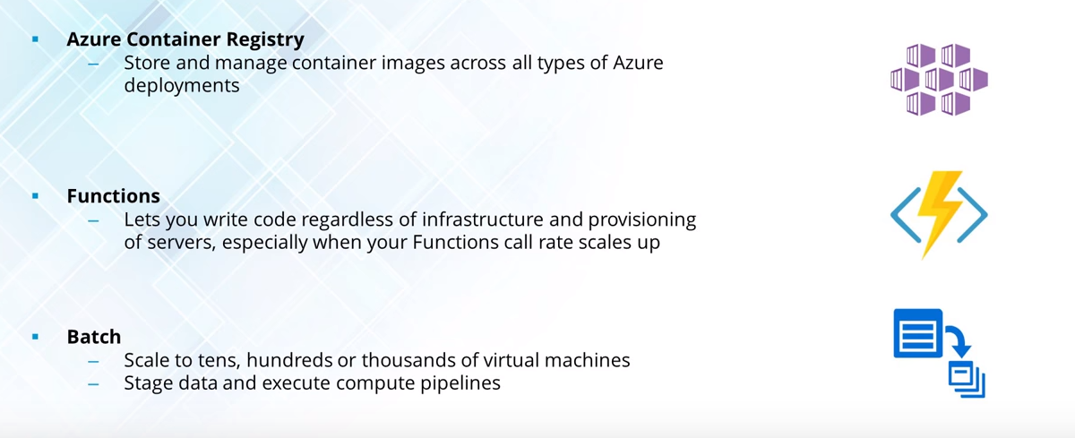
Compute Services con…

Slide 28
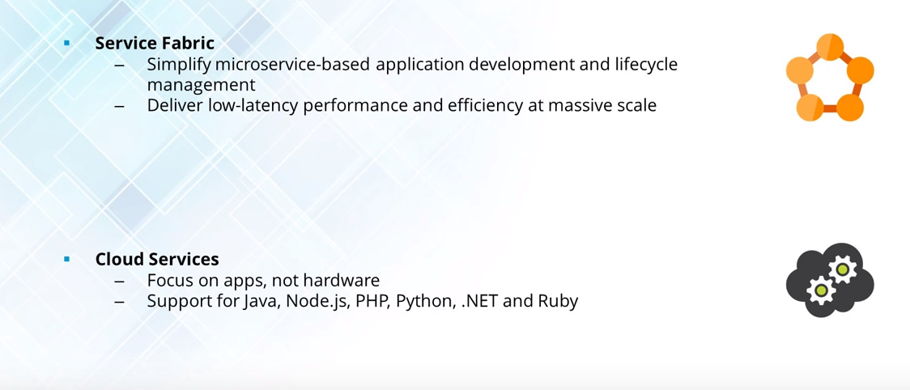
Compute Services con…

Slide 29
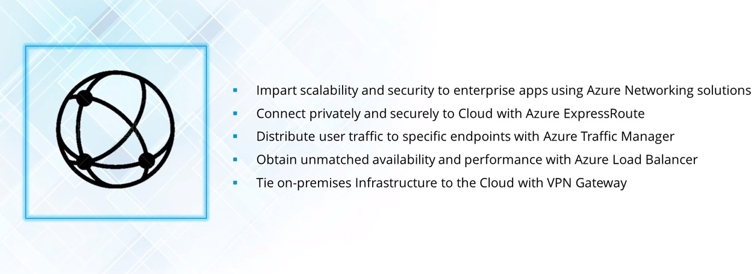
Azure Networking Domain Services
https://www.concurrency.com/blog/w/azure-traffic-manager-vs-azure-load-balancer

Slide 30
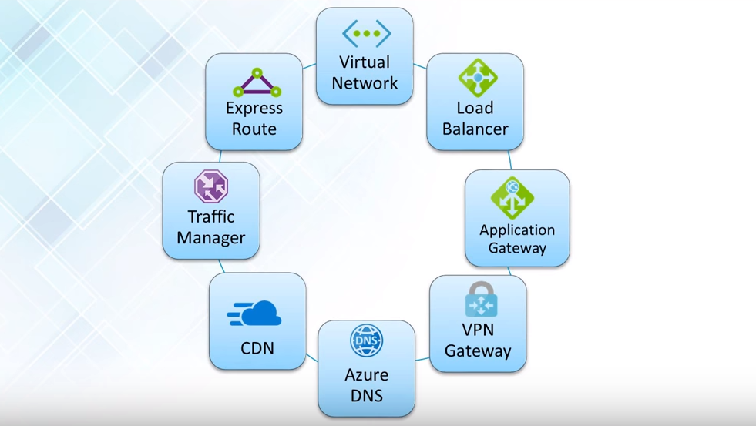
Azure Networking Domain Con…

Slide 31
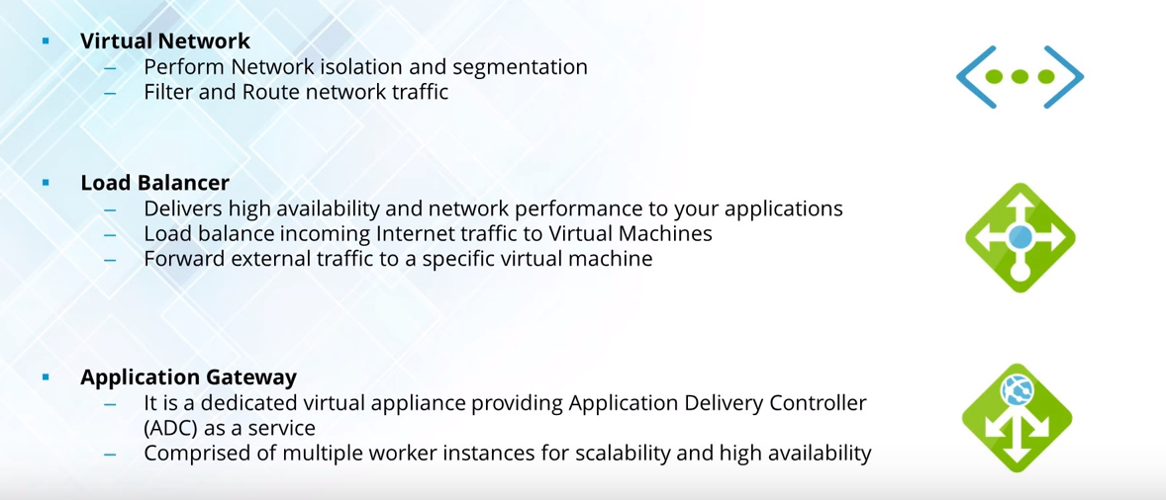
Azure Networking Domain Con…

Slide 32
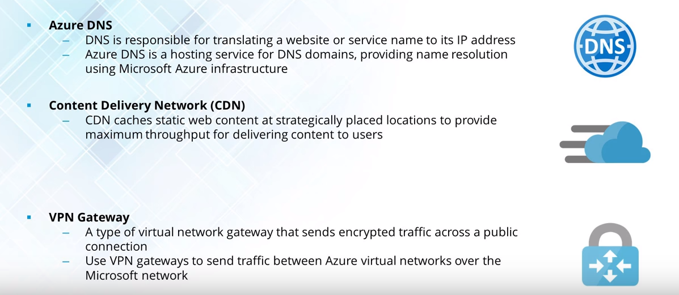
Azure Networking Domain (cont…)

Slide 33
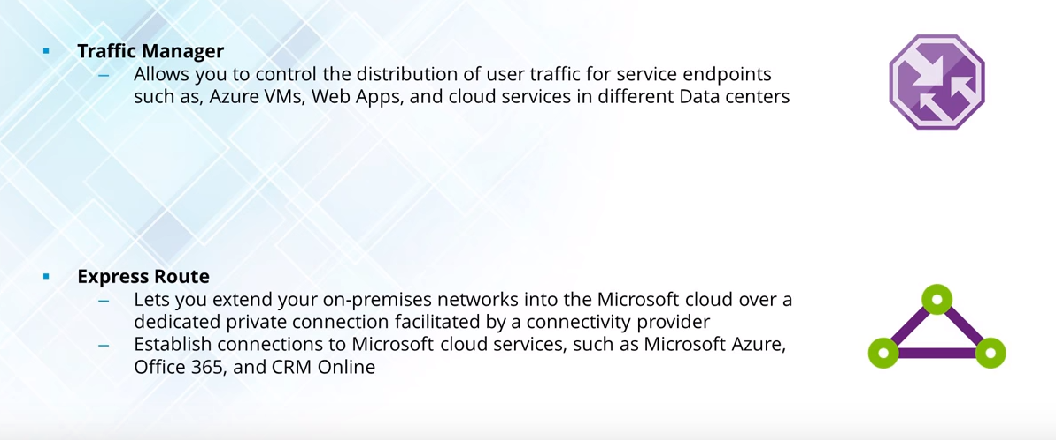
Azure Networking Domain (cont…)

Slide 34
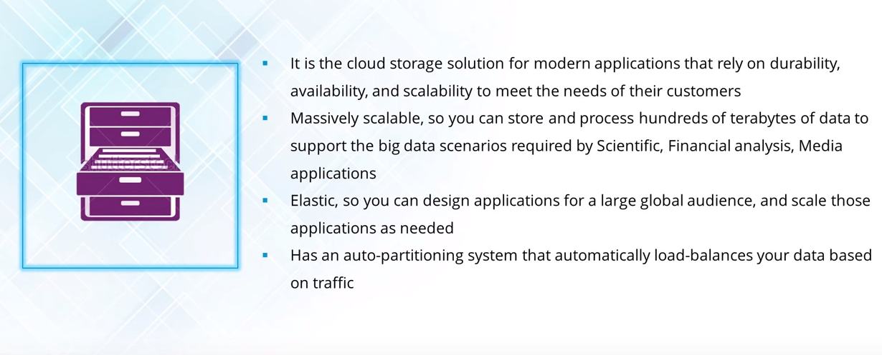
Azure Storage Services

Slide 35
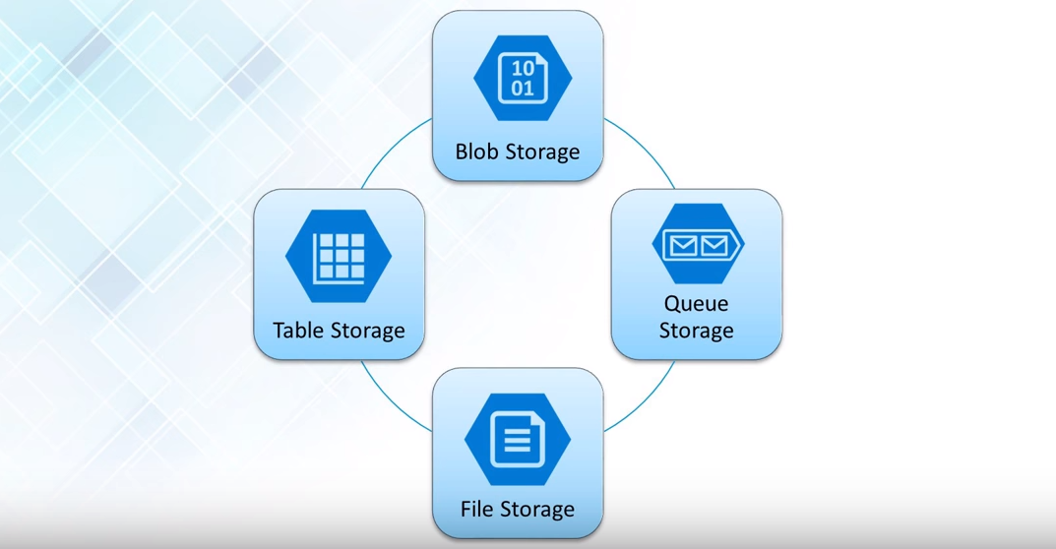
Azure Storage Con…

Slide 36
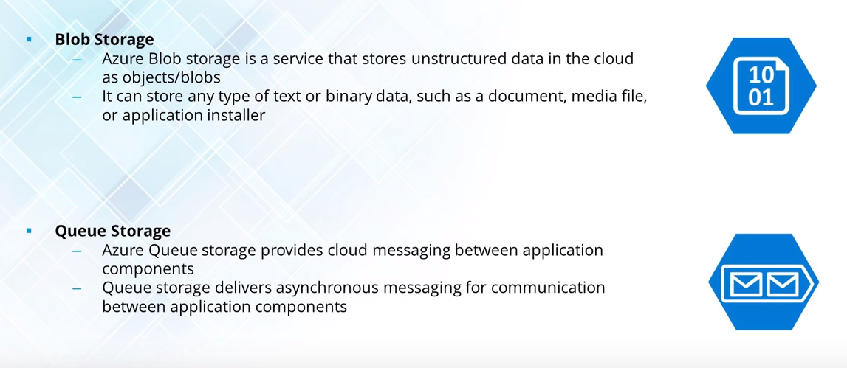
Azure Storage (cont..)

Slide 37
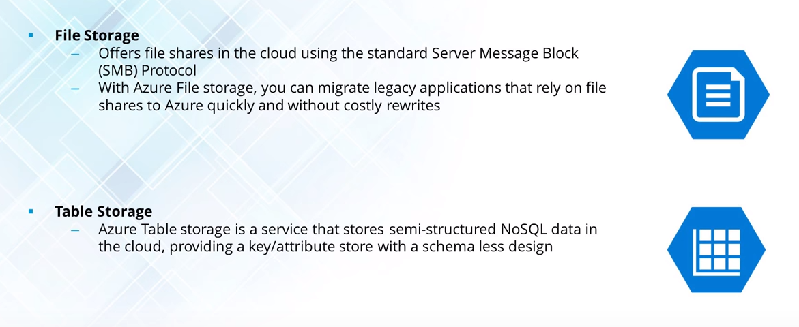
Azure Storage (cont..)

Slide 38
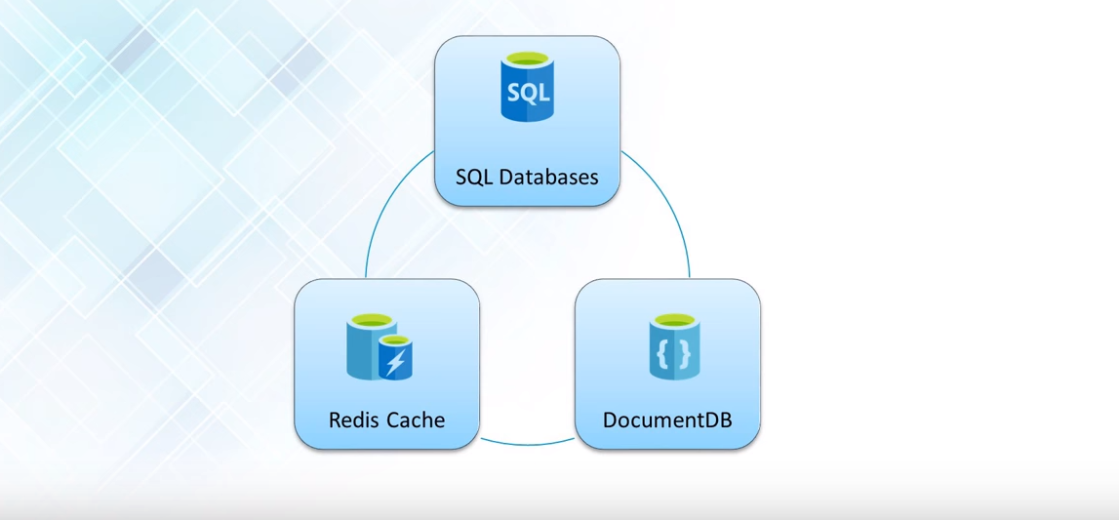
Azure Database Services

Slide 39
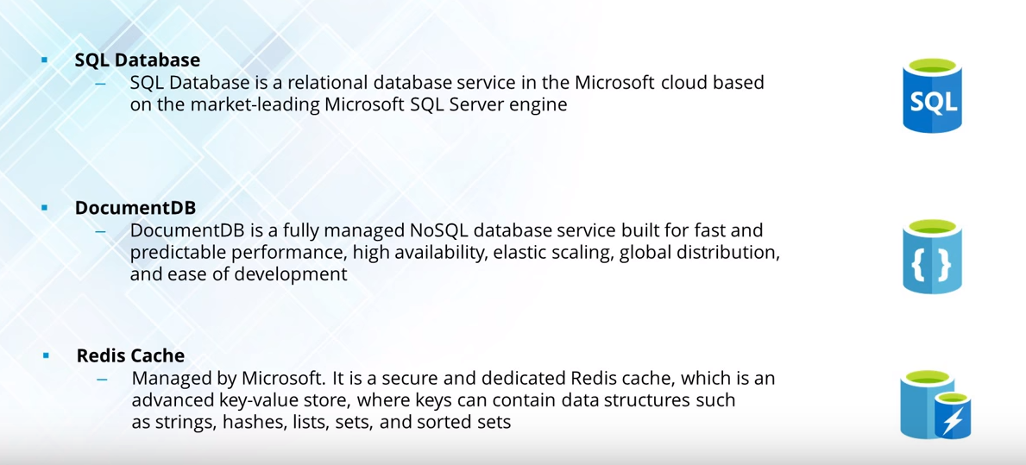
Azure Database Services Con…

Slide 40
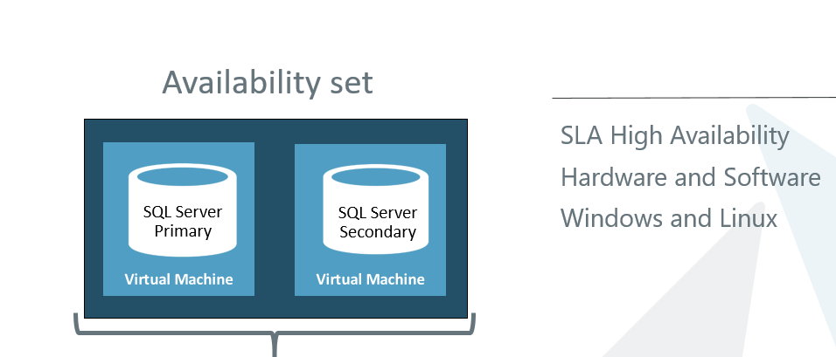
Azure Database High Availability

Slide 41
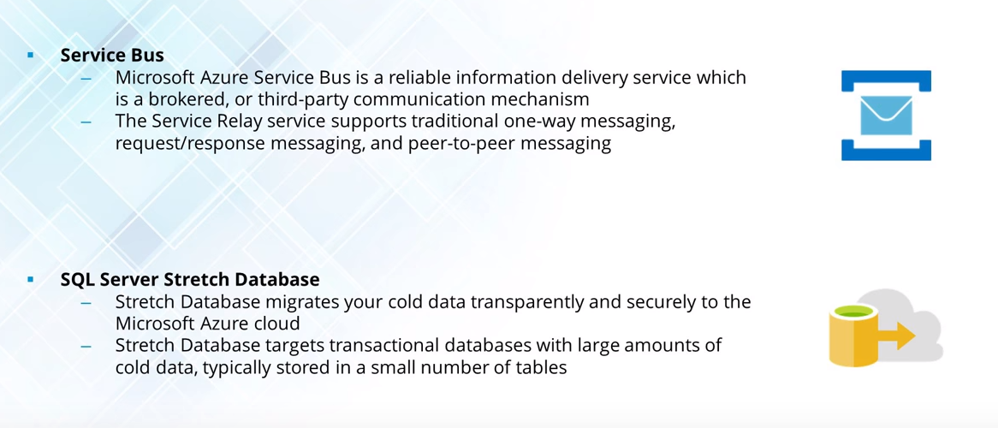
Enterprise Integration Services(SaaS)

Slide 42
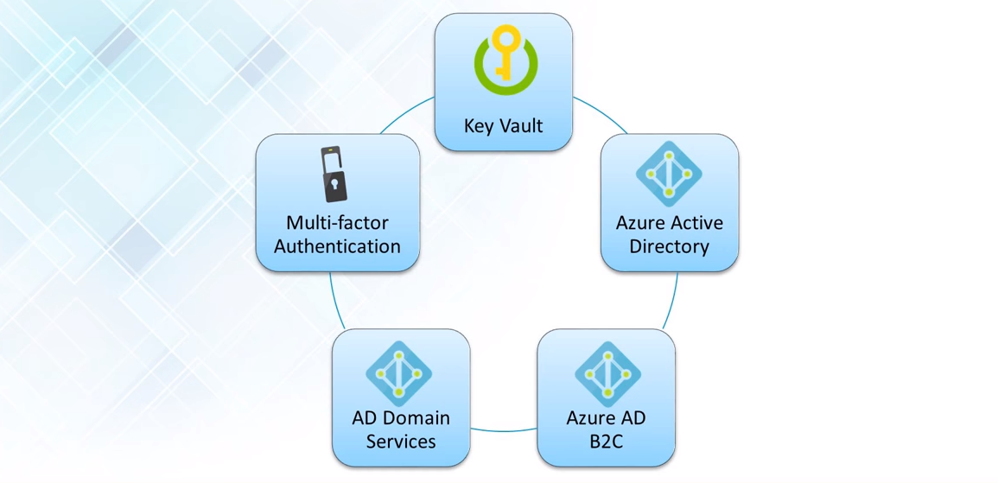
Security + Identity Services

Slide 43
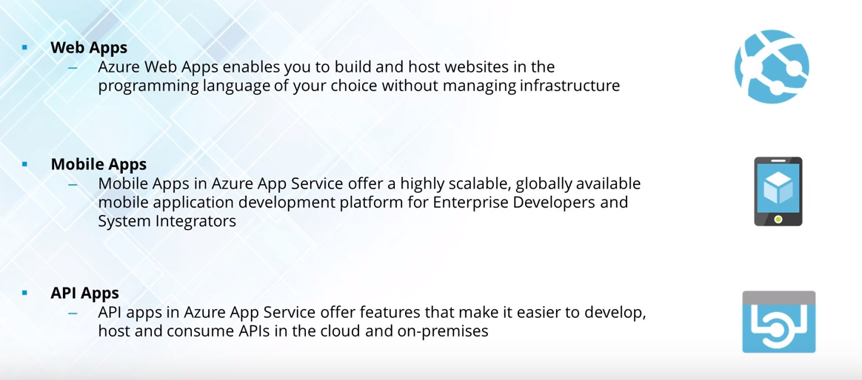
Web + Mobile Services

Slide 44
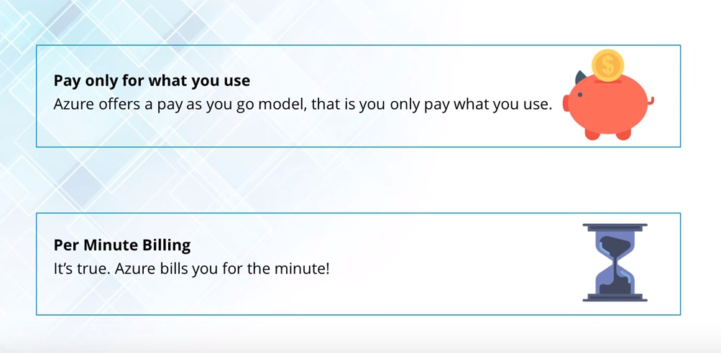
Azure Pricing

Slide 45
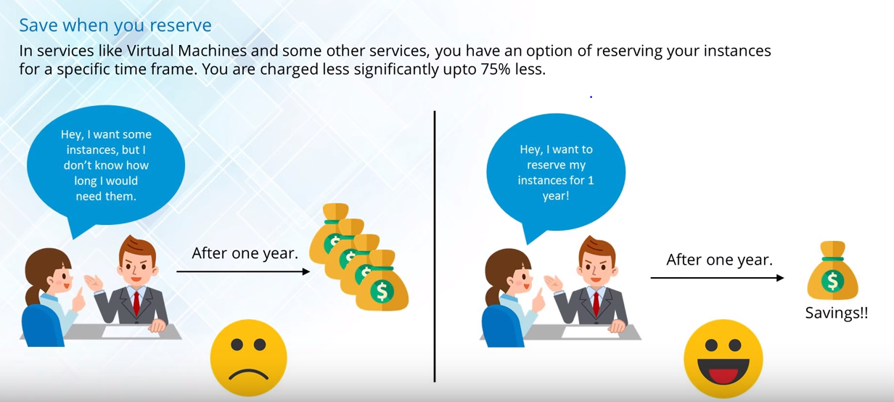
Azure Pricing con…

Slide 46
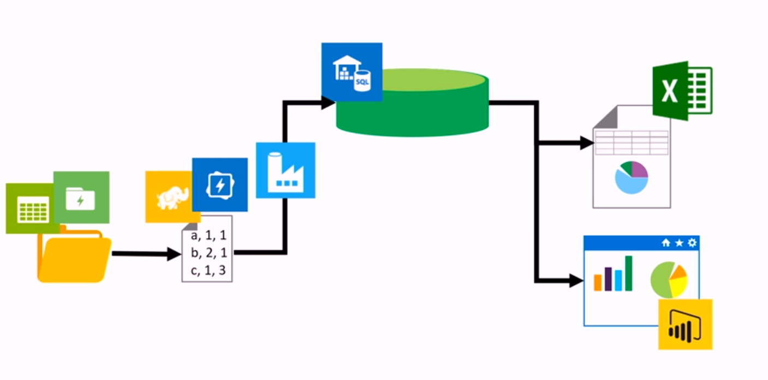
END to END Flow of Data Using MS Azure
ADF(Azure DatawareHouse)
Processing using
Hadoop, HDInsight,
Spark, ADLA using U-sql
Loading to ADW using
ADF
Reports using Power BI or Excel
Azure Storage & Data lake

Slide 47
Steps to create MS Azure Account
Create a Microsoft account id using your existing mail id.
Go to www.azure.microsoft.com
Go to Start free

Slide 48
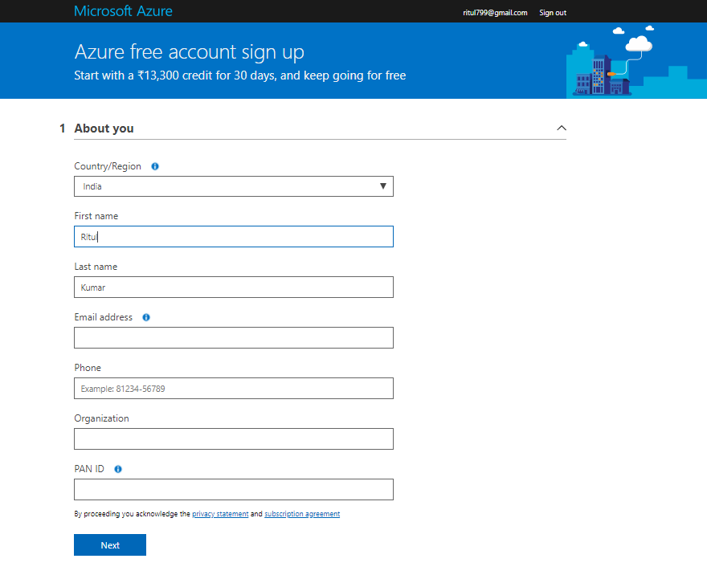
Azure free account sign up

Slide 49
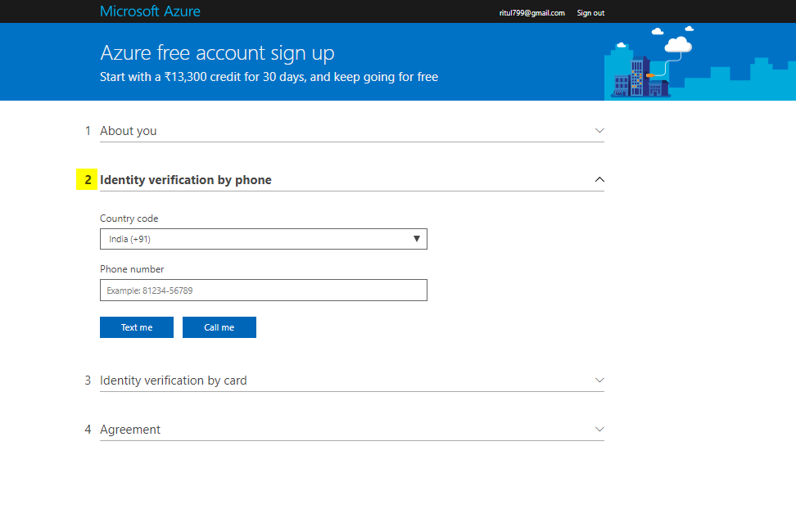
Identity verification by phone

Slide 50
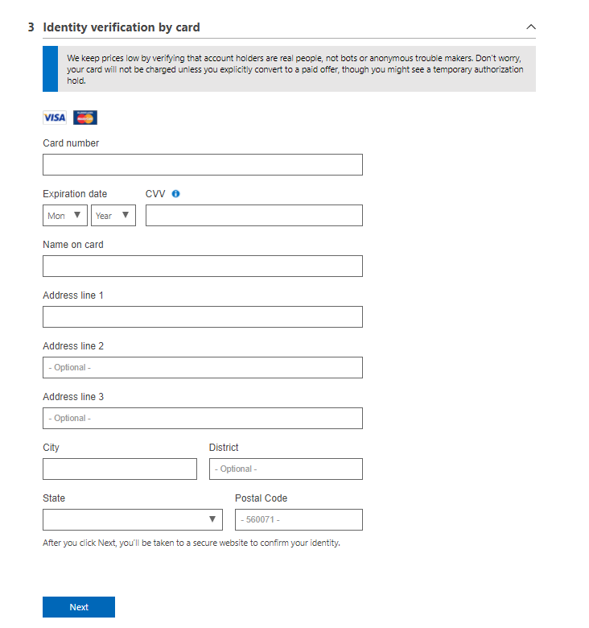
Identity verification by card(Only credit cards Master/Visa)

Slide 51
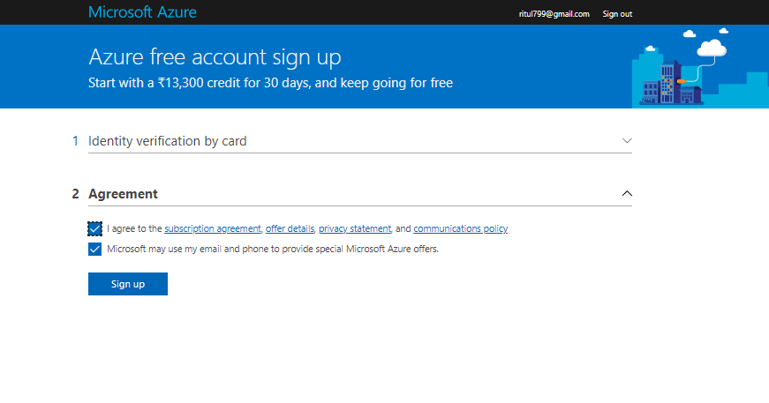
Agreement

